Slide 1
Bagas Dewantoro 201011401595
UTS TESTING DAN QA PERANGKAT LUNAK

Slide 2
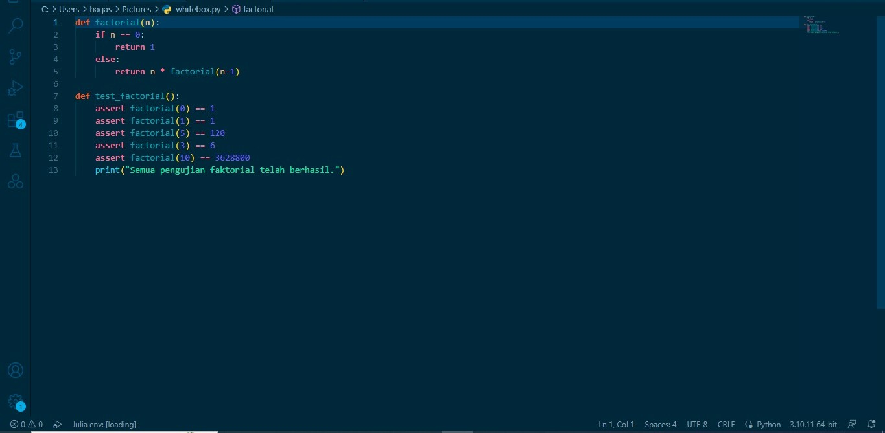
1. a. Contoh white box test

Slide 3
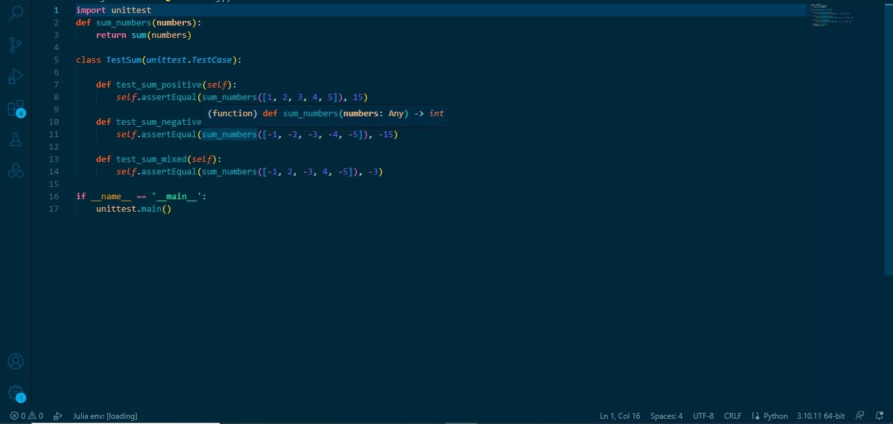
Contoh unit testing

Slide 4
b. Langkah-Langkah konfiguran CI/CD
Pastikan proyek Anda sudah ada di repositori GitHub.
Buat file .github/workflows/python.yml di direktori root proyek Anda.
Isi file python.yml dengan konfigurasi berikut:

Slide 5
name: Python CI/CD
on:
push:
branches:
- main
pull_request:
branches:
- main
jobs:
build:
runs-on: ubuntu-latest
steps:
- name: Checkout repository
uses: actions/checkout@v2
- name: Set up Python
uses: actions/setup-python@v2
with:
python-version: 3.8
- name: Install dependencies
run: |
python -m pip install --upgrade pip
pip install -r requirements.txt
- name: Run tests
run: |
python -m pytest
- name: Deployment
run: |
# Tambahkan skrip untuk melakukan deployment

Slide 6
- Pastikan Anda sudah memiliki file requirements.txt yang berisi semua dependensi proyek Anda.
- Simpan file python.yml dan lakukan commit dan push ke repositori GitHub Anda.

Slide 7
Referensi
GitHub Actions documentation: https://docs.github.com/en/actions
Continuous Integration, Delivery, and Deployment with GitHub Actions" oleh Bukola Ayodele, 20 Juli 2021, https://betterprogramming.pub/continuous-integration-delivery-and-deployment-with-github-actions-91d62b3503f2

